Slide 1

Predicting critical success factors among students of e-learning in a pandemic situation
Statistical Inference I.S.S Fernando 219332D

Slide 2
Methodology
1
Critical review of literature
2
Questionnaire design & circulation
3
Hypothesis development
4
Analysis & results generation

Slide 3
Questionnaire
https://www.academia.edu/12101768/Critical_success_factors_for_e_learning_acceptance_Confirmatory_factor_models
https://www.researchgate.net/publication/343785205_E-Learning_Critical_Success_Factors_during_the_COVID-19_Pandemic_A_Comprehensive_Analysis_of_E-Learning_Managerial_Perspectives

Slide 4
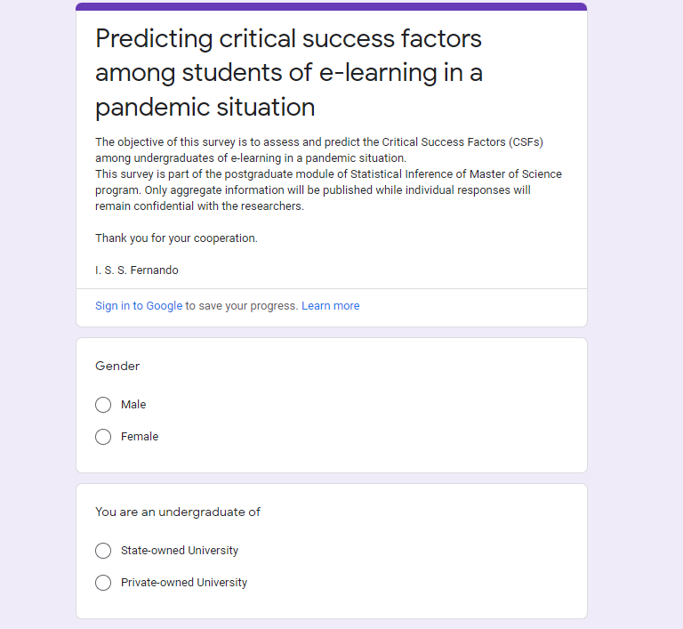
Data Collection
Circulated among undergraduates of Sri Lankan University domain
Questionnaire validated via a pre-run
Exception handling – Diversified inputs

Slide 5
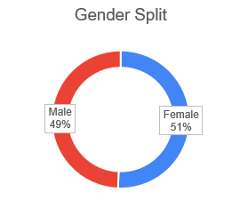
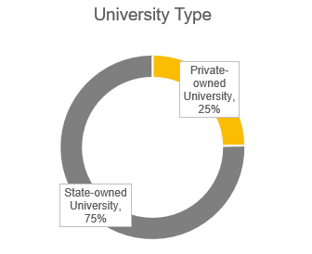
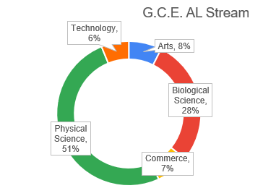
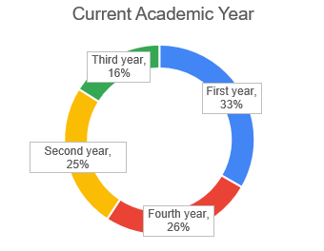
Demographics

Slide 6
Descriptive Statistics
81 Respondents
Tools Used : SPSS and MS Excel

Slide 7
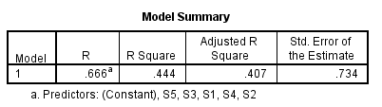
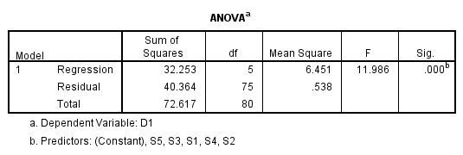
Hypothesis 1
Ho- There is no significant relationship between Student Characteristic (IV1) and Critical Success of e-learning in a pandemic situation among students (DV)
H1- There is a significant relationship between Student Characteristic (IV1) and Critical Success of e-learning in a pandemic situation among students (DV)
R² is 0.444 It means resulted 44.4% of variation in the dependent variable (Critical Success of e-learning in a pandemic situation among students) accounted by the variation on independent variable (Student Characteristic).
Null Hypothesis rejected
The significance value is 0.000(< 0.05),
this p-value is less than the significance level, this indicates that there is a statistically significant
linear relationship.

Slide 8
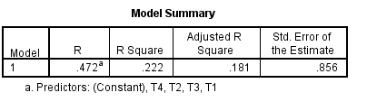
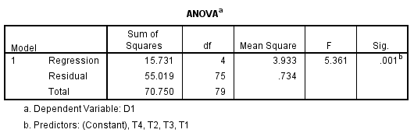
Hypothesis 2
Ho- There is no significant relationship between Technology Characteristic (IV2) and Critical Success of e-learning in a pandemic situation among students (DV)
H1- There is a significant relationship between Technology Characteristic (IV2) and Critical Success of e-learning in a pandemic situation among students (DV)
R² is 0.222 It means resulted 22.2% of variation in the dependent variable (Critical Success of e-learning in a pandemic situation among students) accounted by the variation on independent variable (Technology Characteristic).
Null Hypothesis rejected
The significance value is 0.001(< 0.05),
this p-value is less than the significance level, this indicates that there is a statistically significant
linear relationship.

Slide 9
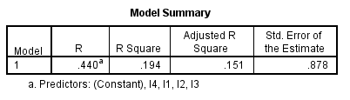
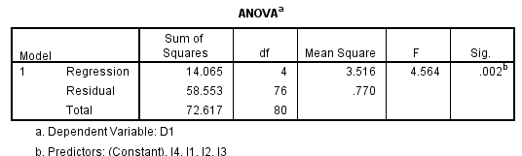
Hypothesis 3
Ho- There is no significant relationship between Instructor Characteristic (IV3) and Critical Success of e-learning in a pandemic situation among students (DV)
H1- There is a significant relationship between Instructor Characteristic (IV3) and Critical Success of e-learning in a pandemic situation among students (DV)
R² is 0.194 It means resulted 19.4% of variation in the dependent variable (Critical Success of e-learning in a pandemic situation among students) accounted by the variation on independent variable (Instructor Characteristic).
Null Hypothesis rejected
The significance value is 0.002(< 0.05),
this p-value is less than the significance level, this indicates that there is a statistically significant
linear relationship.

Slide 10
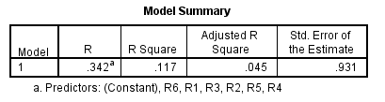
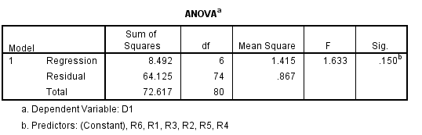
Hypothesis 4
Ho- There is no significant relationship between Resource Characteristic (IV4) and Critical Success of e-learning in a pandemic situation among students (DV)
H1- There is a significant relationship between Resource Characteristic (IV4) and Critical Success of e-learning in a pandemic situation among students (DV)
R² is 0.117 It means resulted 11.7% of variation in the dependent variable (Critical Success of e-learning in a pandemic situation among students) accounted by the variation on independent variable (Resource Characteristic).
Null Hypothesis accepted
The significance value is 0.150(> 0.05),
this p-value is greater than the significance level, this indicates that there is no statistically significant
linear relationship.

Slide 11
Conclusion
Independent Variable | R² value | P value
IV1 - Student | 0.44 | 0.000
IV2 – Technology | 0.22 | 0.001
IV3 – Instructor | 0.19 | 0.002
IV4 – Resource | 0.11 | 0.150
Coefficient of determination (R2 )
proportion of the variation in the dependent variable that is predictable from the independent variable
Used Linear Regression in deriving results – SPSS tool
Student Characteristic cause the most impact to the Critical Success of e-Learning at a pandemic situation as per the context of Sri Lankan university students

